Slide 1
CSL 554 Text and Web Intelligence Analytics
Anjali Goyal (anjaligoyal@ncuindia.edu)
Lecture 5 – 9th August 2018 (Tuesday 09:30 AM – 10:20 AM)

Slide 2
For a conjunctive query, is processing postings list in
order of size guaranteed to be optimal? Explain
why it is, or give an example where it is not

Slide 3
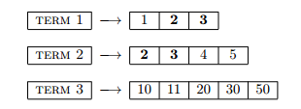
Processing postings list in order of size (i.e. the shortest postings list first) is usually a good approach.
But it is not optimal e. g. in a conjunctive query with three terms:
As we can see there is no document containing all three query terms. If we would have checked the first posting of the third list right at the beginning, we would have noticed that there is no intersection between the first and the third postings list. That would make any further search superfluous.

Slide 4
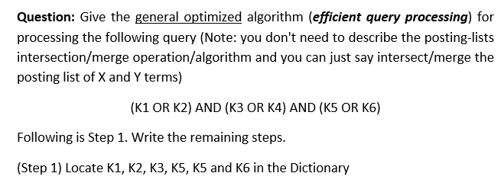
Left Blank for Students to Solve

Slide 5
From Sets to Rankings
Precision and Recall are measures of sets
In a ranked list, we can measure the precision at each recall point
recall increases when a relevant document is retrieved
compute precision at each relevant retrieve document, over that fraction of the retrieve set

Slide 6
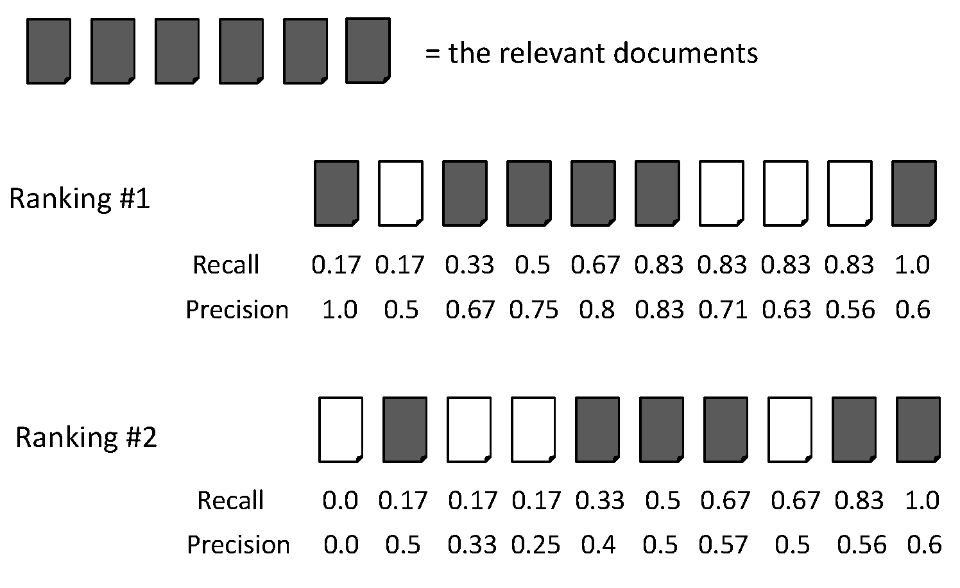
From Sets to Rankings
Precision and Recall are measures of sets
In a ranked list, we can measure the precision at each recall point
recall increases when a relevant document is retrieved
compute precision at each relevant retrieve document, over that fraction of the retrieve set

Slide 7
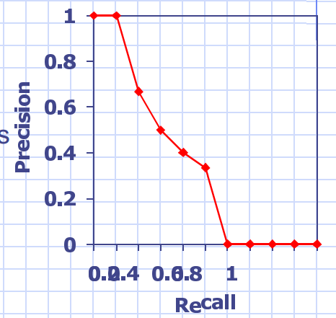
Recall-Precision Graphs
Shows the retrieval
performance at each
point in the ranking
Graph precision at
standard recall points
10%, 20%,…,100%

Slide 8
The recall-precision graph illustrates the tradeoff made by a search algorithm
Shows system performance at multiple operating points
Each user may be interested in a different point on the graph

Slide 9
Performance Evaluation of a Retrieval System
often it is useful to have a single number to summarize performance
Precision at n documents retrieved shows set precision at fixed points in the ranking
R-precision
Precision when (# relevant documents) retrieved
Average precision
Average of precision at each relevant document retrieved
Precision of an unretrieved relevant document = 0

Slide 10
Average Precision: Example

Slide 11
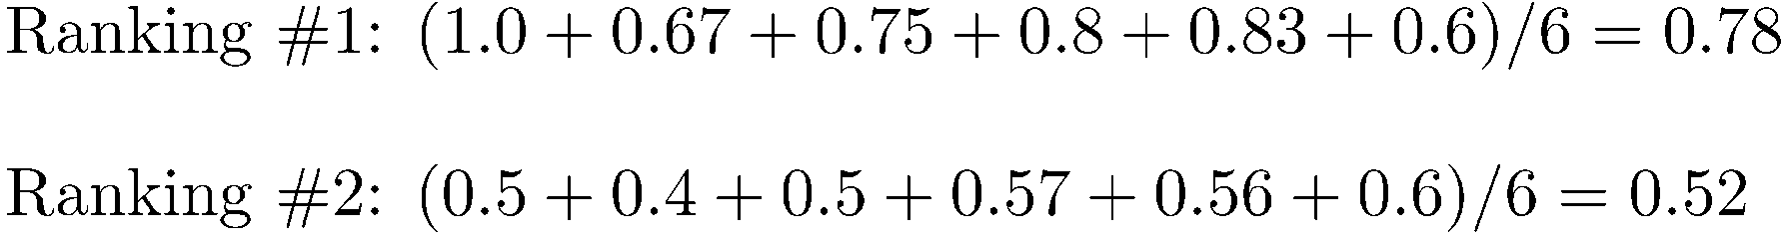
Average Precision: Example

Slide 12
Average Precision: Example

Slide 13
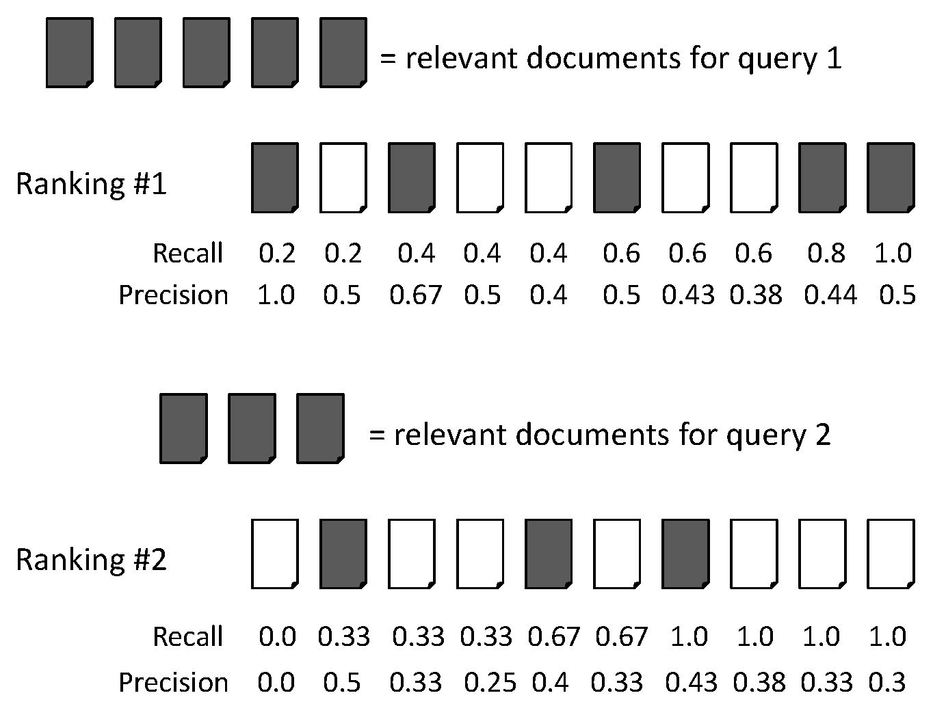
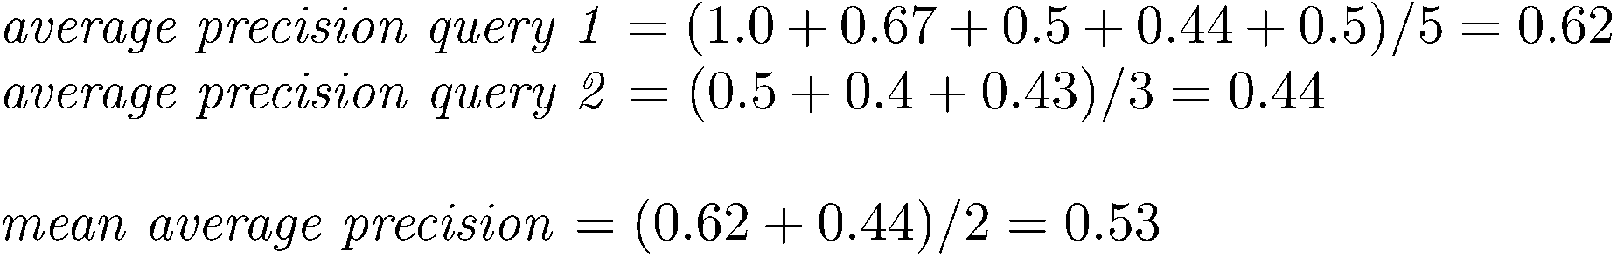
Mean Average Precision (MAP)

Slide 14
Mean Average Precision (MAP)
Summarize rankings from multiple queries by averaging average precision
Most commonly used measure in research papers
Assumes user is interested in finding many relevant documents for each query
Requires many relevance judgments in text collection

Slide 15
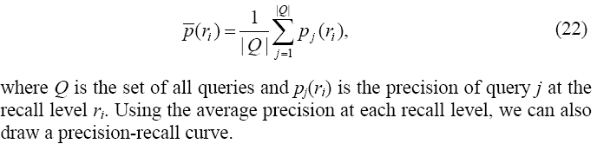
General Formula for MAP
Compute the average precision at each recall level.

Slide 16
Exercise:
Following is the precision-recall graph of an IR system on a particular topic. 20 documents are retrieved, and that there are 16 relevant documents for this topic (not all of which are retrieved). ) In the diagram below, each box represents a hit. Based on the given precision-recall graph, which hits are relevant? Write an “R” on the relevant hits. Leave the non-relevant hits blank.
What is the Mean Average Precision (MAP)?

Slide 17
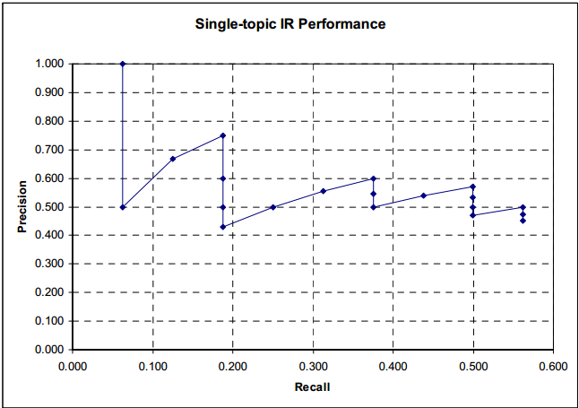
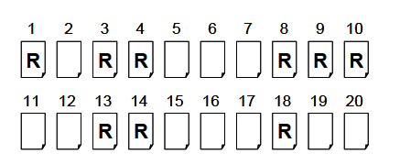
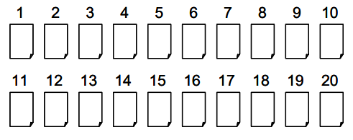

Slide 18
Mean Average Precision
Error: Divide by 9 and not 16

Slide 19

Thank You

